Slide 1



UNIT 6:
Around the world
The story of hurricanes

Slide 2
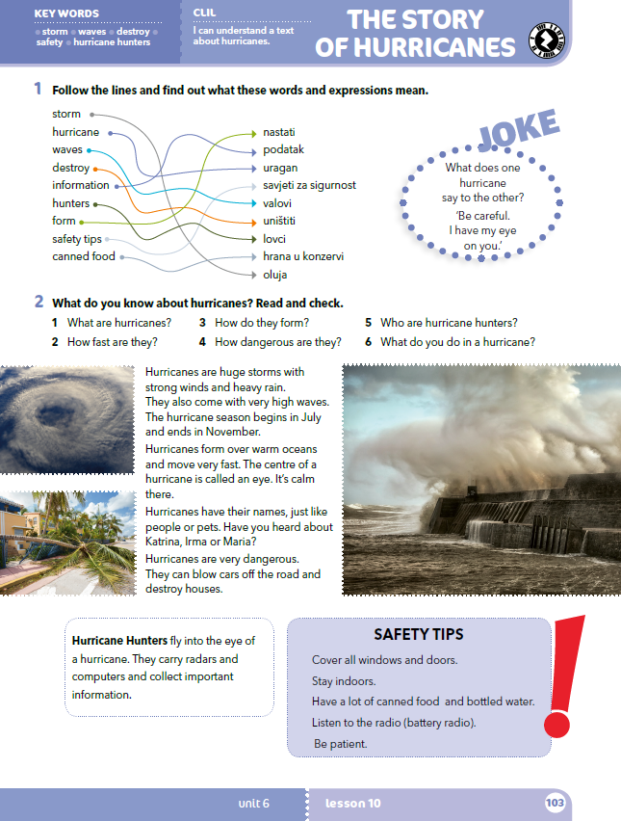
What’s the topic of this lesson?
Do you know anything about hurricanes?
Do you know any hurricane names?
Do you know any names of storms in Croatia or Europe?

Slide 3
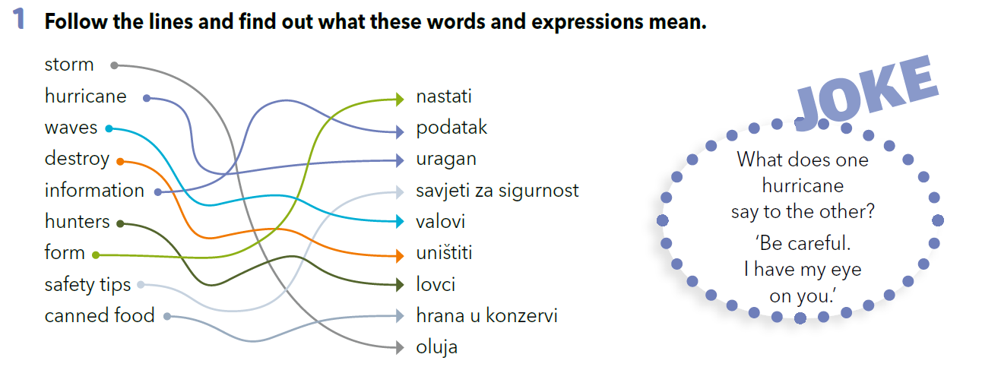

Slide 4
Check your knowledge.
https://wordwall.net/resource/260283/story-hurricanes-task-1-vocabulary

Slide 5
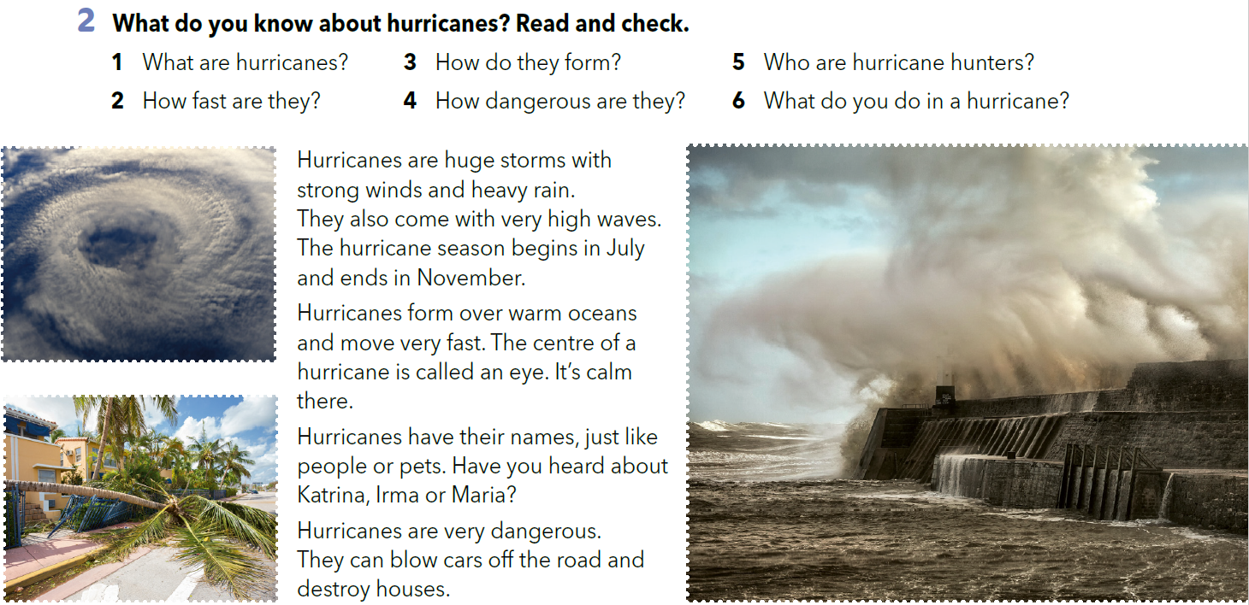
Look at the photos from task 2 and describe them.

Slide 6
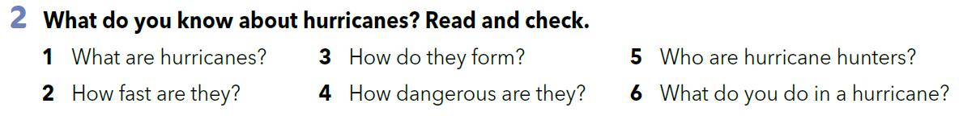
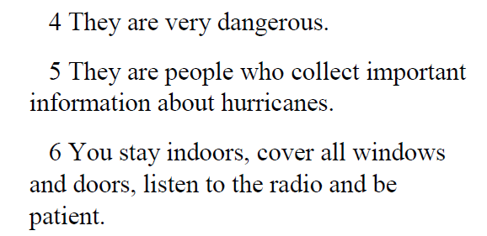



Work in pairs. Answer the questions without reading the text.
Read the text and check your answers.

Slide 7
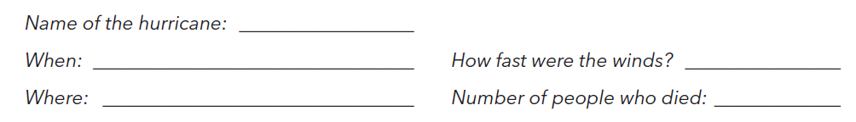
Učitelj će te podijeliti u jednu od tri grupe. Svaka grupa istražuje jedan od uragana i ispunjava radni listić:
grupa 1 – uragan „Irma”
grupa 2 – uragan „Katrina”
grupa 3 – uragan „Maria”
Let’s practise!
https://wordwall.net/play/260/281/290

Slide 8
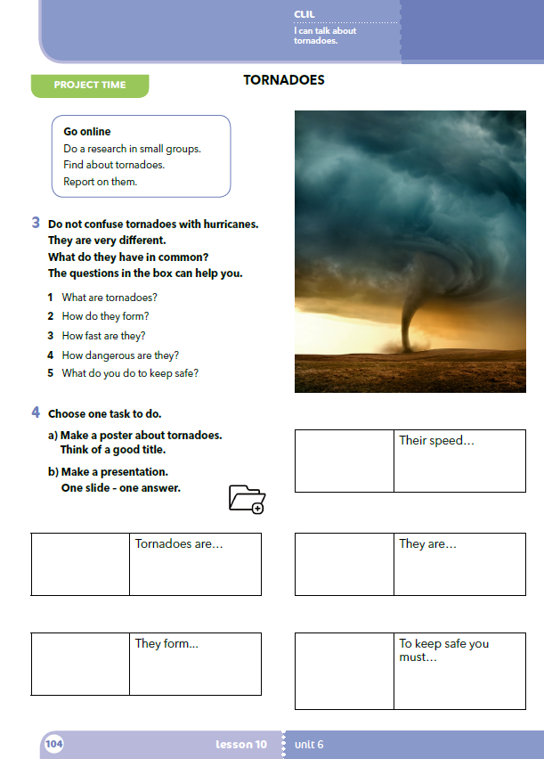
What can you see in the picture?
Do you think it’s dangerous? Why?

Slide 9
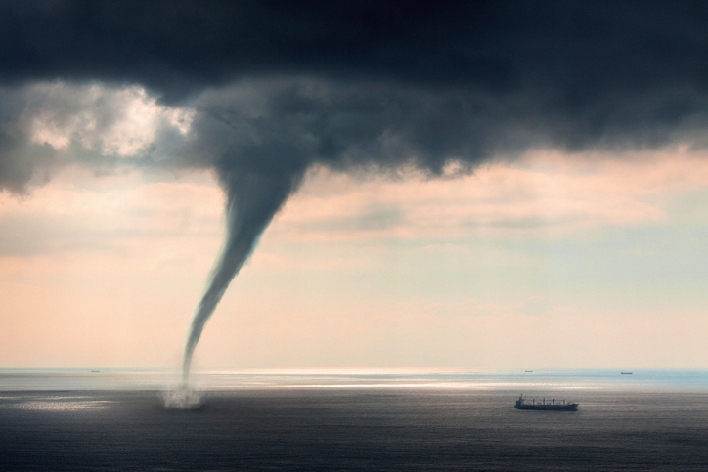
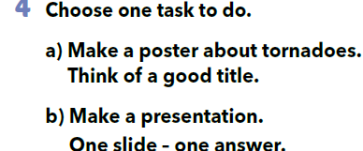
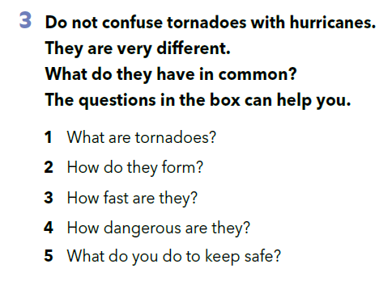
PROJECT TIME

Slide 10
U izradi rada mogu ti pomoći sljedeće stranice:
http://www.sciencekids.co.nz
www.natgeokids.com
https://kids.britannica.com
Prezentiraj svoj rad u maloj grupi ostalim učenicima.
U svoje bilježnice napiši osvrt na prezentacije učenika koje si slušao (koji su elementi bili dobri, a koji bi mogli biti bolji).

Slide 11

LEARN MORE
https://www.e-sfera.hr/dodatni-digitalni-sadrzaji/4e4c36ba-e98f-482e-9504-b2ef77a42d31/
Disasters and what to do

